Slide 1
Computer vision with Keras

Slide 2
Content
Libraries installation
Neural network intro.
Image
Neural network structure
Sequential model
Conv2D layer
Feature map
Max Pooling layer
Flatten and Dense layers
Image classification model using VGG16

Slide 3
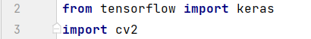
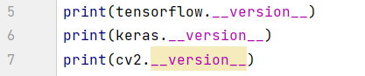
Libraries needed
TensorFlow:
A framework from Google have many libraries can be used in computer vision tasks.
Keras:
An API works on top of tensorflow.
OpenCV:
Library used to perform image processing and computer vision tasks.
Installation:
Checking version:

Slide 4
Content
Libraries installation
Neural network intro.
Image
Neural network structure
Sequential model
Conv2D layer
Feature map
Max Pooling layer
Flatten and Dense layers
Image classification model using VGG16

Slide 5
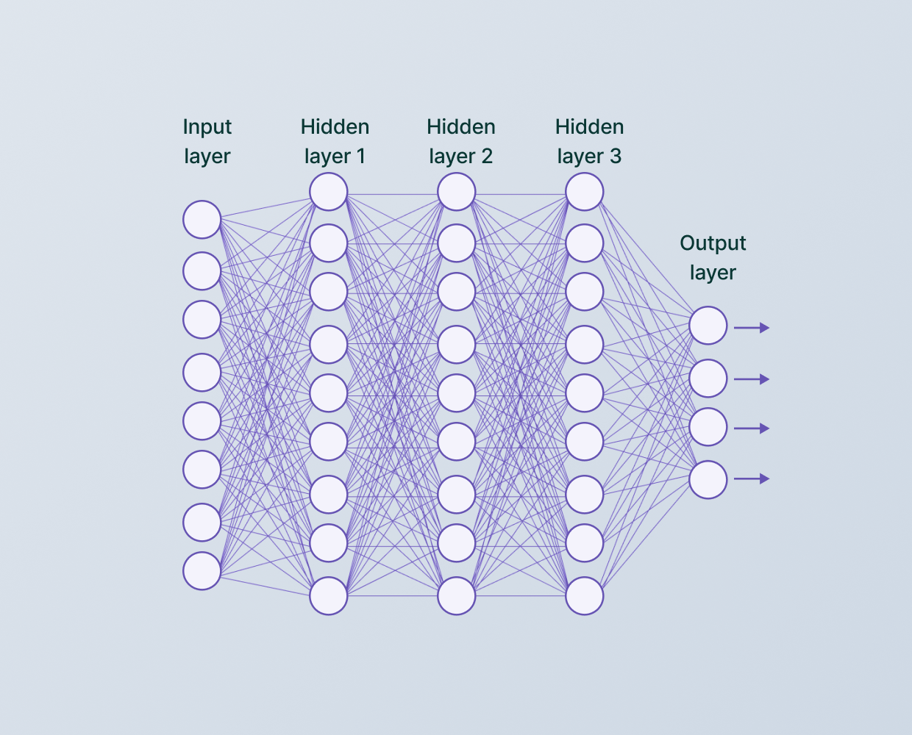
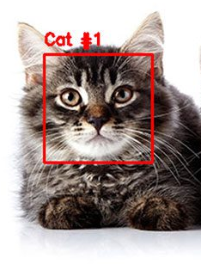
Neural Network
Neuron
It consists of many layers, the first layer takes the input image, then the image passes into one/more hidden layers to perform some process on it, then the output layer returns the input image concatenated with the specified task. For example, if we are performing a classification task to return if the image is for cat or dog, it will return the image of the animal concatenated with a boundary box around the animal with a text of the type of this animal either cat or dog.

Slide 6
Content
Libraries installation
Neural network intro.
Image
Neural network structure
Sequential model
Conv2D layer
Feature map
Max Pooling layer
Flatten and Dense layers
Image classification model using VGG16

Slide 7
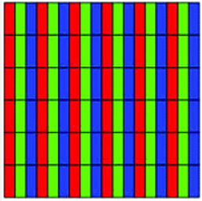
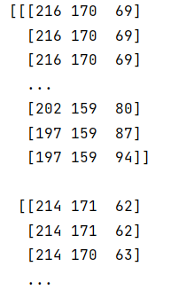
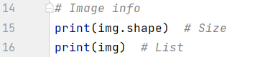
Image
It is a list of rows and columns, each pixel (row, column) represents the brightness of each main color, in other words, represents the intensity of the RGB colors (Red Green Blue)
Ex:
(Row0, column 0) [R G B] -> Pixel 0
(Row 0, column 1) [R G B] -> Pixel 1
(Row 0, column 2) [R G B] -> Pixel 2
. . . . . . .
(Row 0, column n-2) [R G B] -> pixel n-2
(Row 0, column n-1) [R G B] -> pixel n-1
(Row 0, column n) [R G B] -> pixel n
(Row 1, column 0) [R G B]
(Row 1, column 1) [R G B]
(Row 1, column 2) [R G B]
. . . . . . . .
To know information about the image:

Slide 8
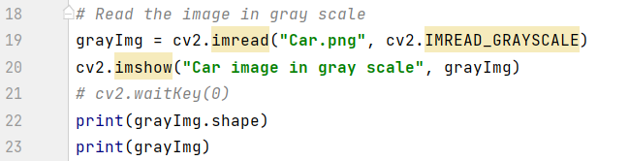
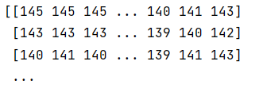
In detection task, there is no need for colors. if we want to detect something in an image, we can convert the input image into grayscale image which makes the image in black and white only which is one channel of RGB, this results that each pixel will have one value instead of three.
Reading the image in grayscale:
Img output:
This image will be the input layer of neural network.

Slide 9
Content
Libraries installation
Neural network intro.
Image
Neural network structure
Sequential model
Conv2D layer
Feature map
Max Pooling layer
Flatten and Dense layers
Image classification model using VGG16

Slide 10
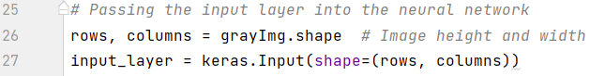
Neural Network structure
How to append layer/s into the neural network?
This is done using function `Input()` via passing the shape of the input image into its shape parameter. If we print the shape of the input layer, it will be the same as the shape of the input image, but will have another dimension. This dimension refers to number of batches, which are images inputted into the input layer.

Slide 11
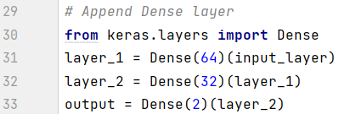
After the input layer, there is/are hidden layer/s where the processing is done, one of these layers is called “dense” layer. To append it to the neural network, we have to create it by passing the number of neurons(depends on the model itself), and then connect it to the input layer.

Slide 12
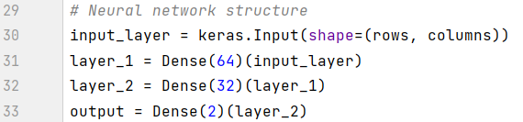
These layers and connection between them is called Neural Network Structure.
After building our neural network layers, we have to define the model to apply on it, by passing the input layer and output layer as parameters to the `Model()` function.

Slide 13
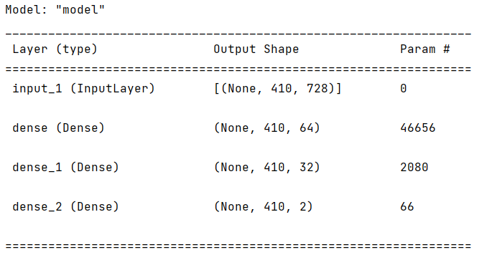
To get a summary of the model, layers and shapes:
The output:
Code

Slide 14
Content
Libraries installation
Neural network intro.
Image
Neural network structure
Sequential model
Conv2D layer
Feature map
Max Pooling layer
Flatten and Dense layers
Image classification model using VGG16

Slide 15
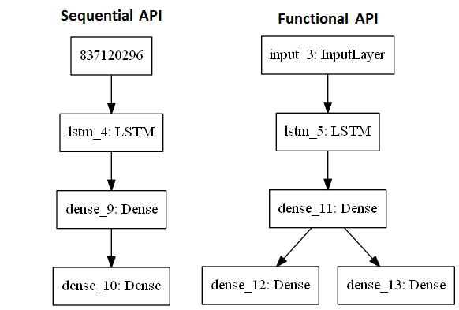
Sequential model
Keras provides two ways to create the model, Functional API model and Sequential API model. Sequential API model is simpler but less flexible than functional API model.
In sequential model, we need a sequence of layers of the top of eachother, so if we want for example to split the model on the 2nd layer and separately use this layer to connect to other layers, we can not do this with sequential model, we will need to use functional model. [This is called layers sharing and branching].
Most of the time in computer vision, for example in YOLO models and other models, we use the sequential API models.

Slide 16
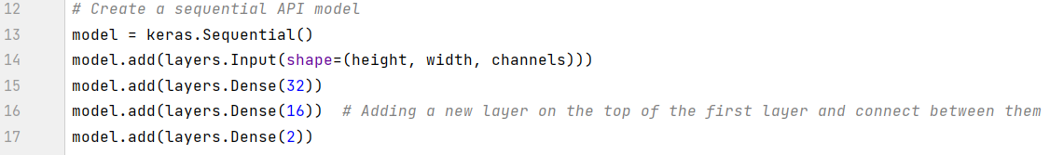
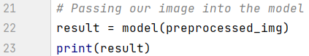
How to build the sequential API model?
To make sure that our neural network is running well without any errors, we need to pass our image into the model.

Slide 17
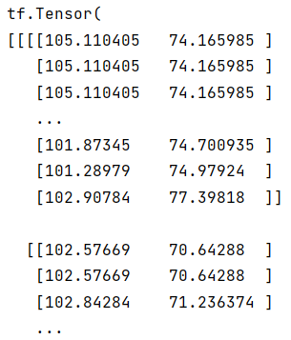
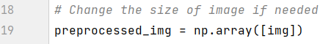
The output of the model will be multi-dimensional matrix which doesn’t represent anything rightnow, but it will have meanings once we use a real model for specific task like detection, classification, etc…
We may get an error if the shape of our image doesn’t match the expected shape to the model, so we may need a simple preprocessing step to change the image shape. To do this, we simply put the image inside an array.
Output of the model be like:
Code

Slide 18
Content
Libraries installation
Neural network intro.
Image
Neural network structure
Sequential model
Conv2D layer
Feature map
Max Pooling layer
Flatten and Dense layers
Image classification model using VGG16

Slide 19
Conv2D Layer
Introduction
The convolution operation is used in computer vision usually to extract information from the image or to manipulate the image (extract features like horizontal/ vertical/ etc.. edges & manipulation like blurring).
In the specific case of convolution neural networks, it get more complex; because we will use this to extract features from an image.
The first thing we do usually in convolution neural networks is the convolution operation, so the first layer that takes the images will be the convolution layer.
We need to resize the shape of our image, as it is simpler to be processed [Note that we can detect the dog from the image either the image is big or small].

Slide 20
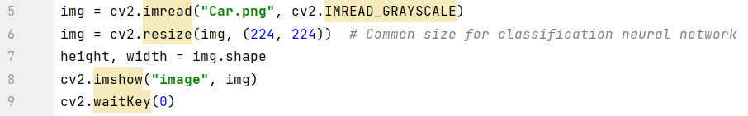
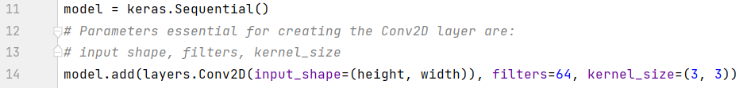
So, we will at first load and resize our image:
To create the convolution layer:

Slide 21
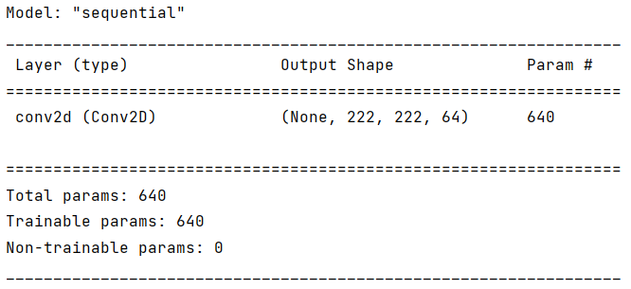
In order to extract the information from this layer, we need to access the weights that are created each time we add a layer. If we check the summary of the model, we get params for each layer. These are values that we can access.
The params are the filters that are generated as a result from features extraction, each one of them represents a feature.

Slide 22
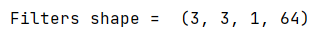
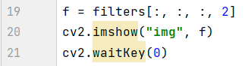
To access the first filter:
The output will be:
So, the kernel_size parameter is the size of the images that will be used as features and the filters argument is the number of filters/features generated.
Another way to get the 3rf filter(feature image):

Slide 23

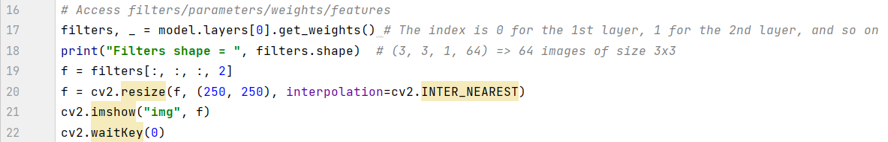
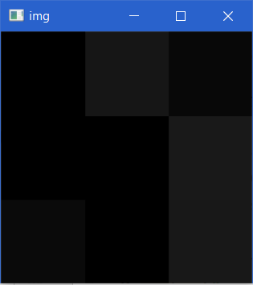
The output be like:
The kernal_size which is the size of each feature/filter’s pixel is 3x3 which is very small.
So, we can resize it to be more clear to see:
To increase the pixels size without blurring occurrence.
Output

Slide 24
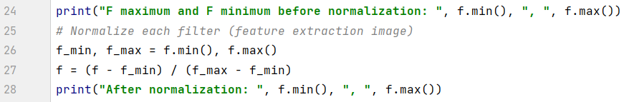
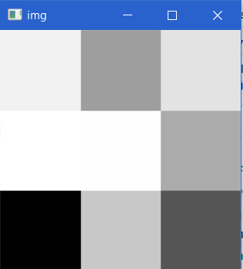
The divergence in pixels colors is not clear, so to solve this, we need to perform normalization which means limiting the pixels brightness intensity range from between 0 and 1, where 1 is the maximum and 0 is the minimum, this is done by:
The output:

Slide 25
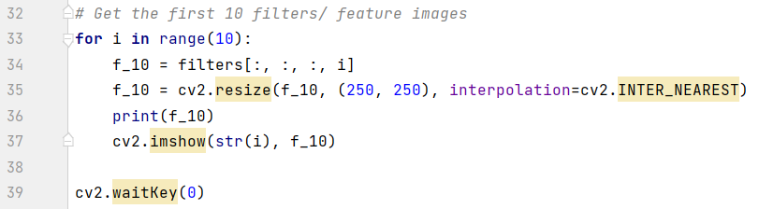
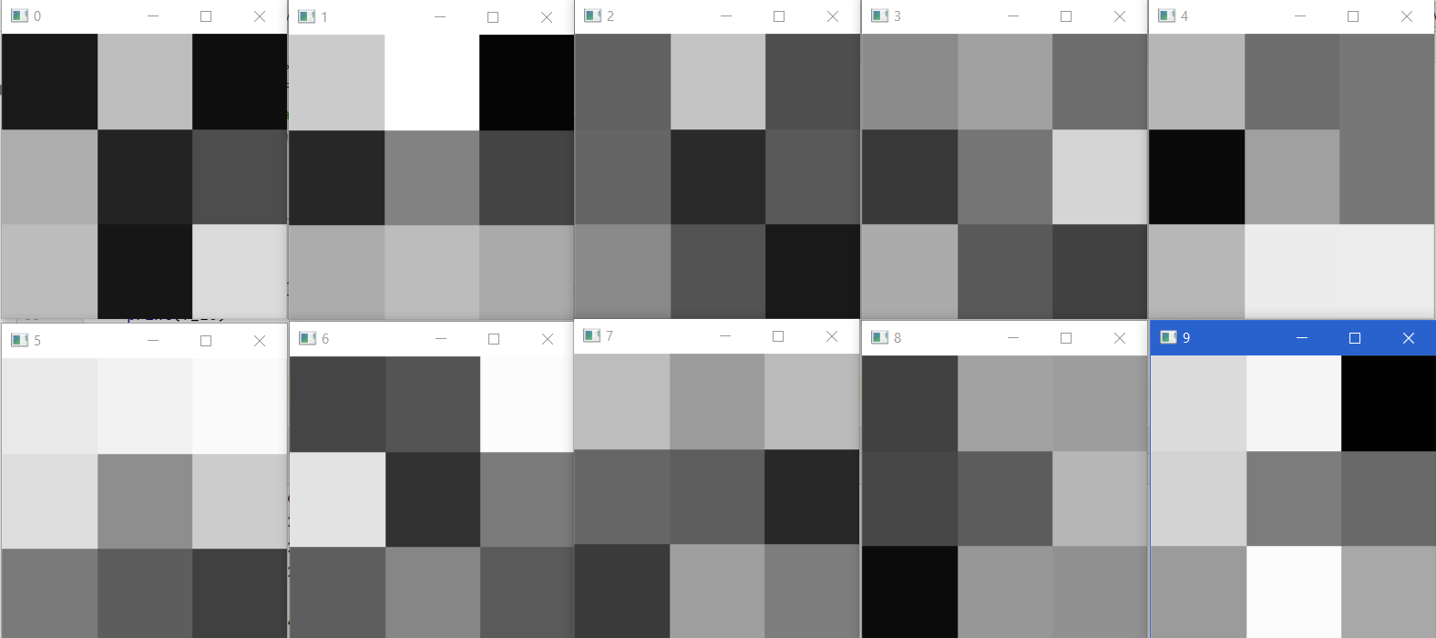
To get the first 10 filters/ params/ feature images:
Output:

Slide 26
What does this output represent?
Features extraction from an image to create a feature map. In other words:
The `kernel_size` represents the complexity of the feature, so the bigger kernel_size, the greater feature complexity.
The number of `filters` represents the number of features that we can get.
Note that:
The `kernel_size` parameter is usually a square, ((3, 3)/ (5, 5)/ (7, 7)/ etc…).
The `filters` parameter depends on the type of neural network, (detection/ classification/ etc…).
Code

Slide 27
Content
Libraries installation
Neural network intro.
Image
Neural network structure
Sequential model
Conv2D layer
Feature map
Max Pooling layer
Flatten and Dense layers
Image classification model using VGG16

Slide 28
Feature map
The feature map is the result of the features that we extract from the convolution layer.
Usually in computer vision, we shrink all images to a standard square size. Each model has its own size.
If the size is a rectangle not a square, we’ve to resize it as it is the standard in CV. Surely, we will lose some proportion as if the image is wide and we shrink it, some proportion will be lost, but it is how it works.

Slide 29
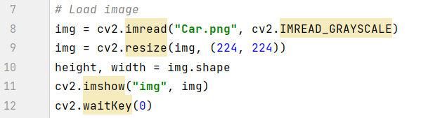
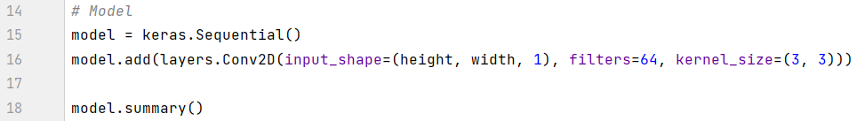
The first step: Load the image and resize it:
The model takes the input image/layer and gives the output of the last layer.
The second step is building the model:

Slide 30
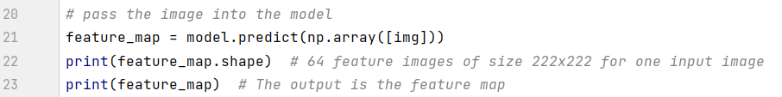
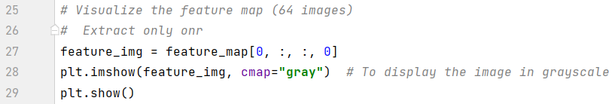
3rd step: Passing the input image into the model, to start features extraction after convolution layer:
`np.array()` method takes the input image in a list, as the neural network is designed to get multiple images as input layer not only one image.
4th step: Extract the features and visualize them:

Slide 31
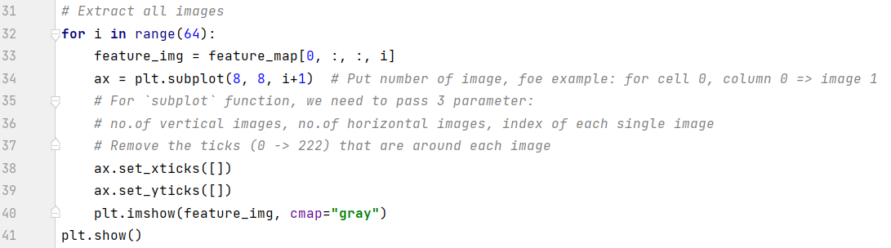
We can also get all the features extracted whose number is defined in the code in `filters=64` parameter.
Note that:
It is better to visualize the features images in Matplotlib than OpenCV.

Slide 32
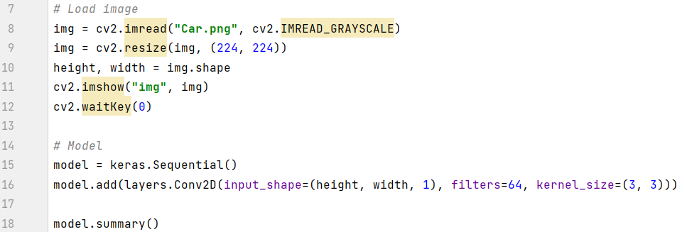
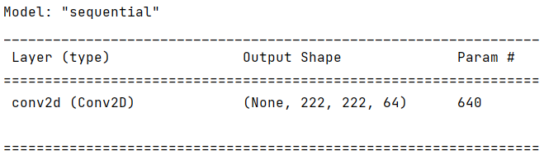
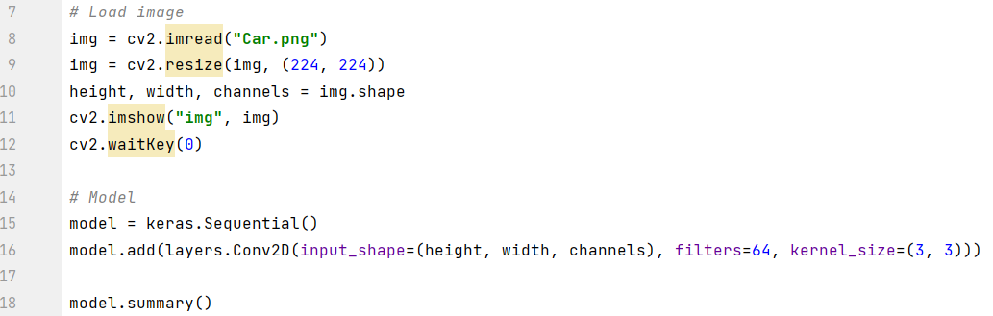
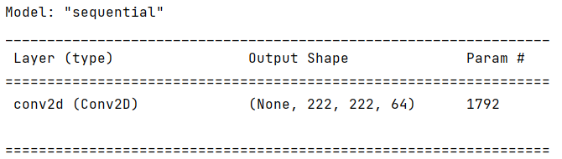
We can pass the input image in 3-channel colors or in grayscale, but the no.of params/weights will increase in case of 3-channel colors. Choosing between them depends on the model.
Params for grayscale
Params for 3-channel colors

Slide 33
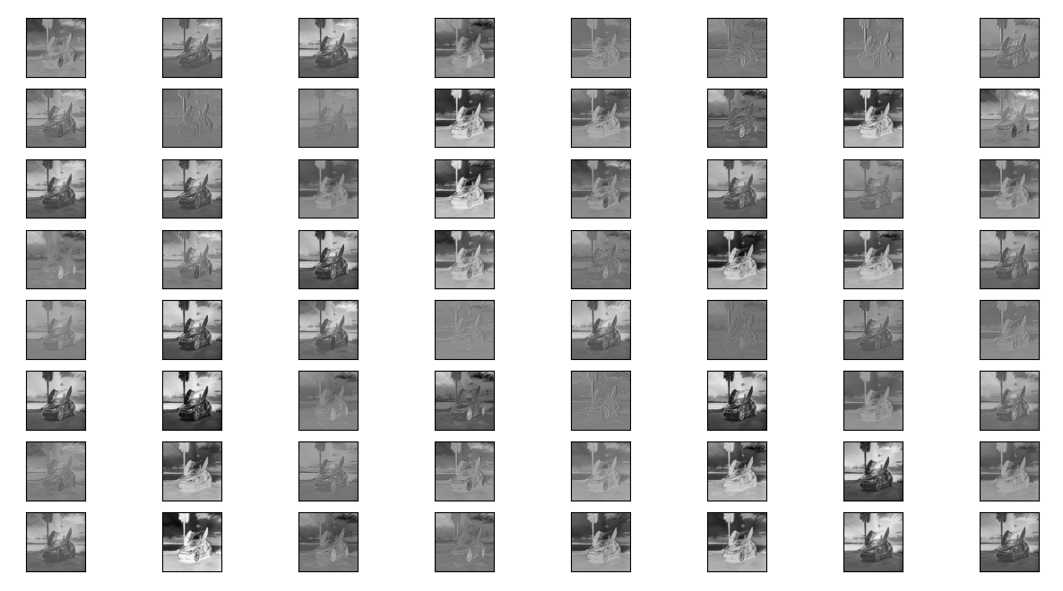
Feature map:

Slide 34
What is the purpose of feature map?
The purpose of the feature map is to extract features; as the further we go inside the model close to the output level, the less information we have.
The concept is for example, for face recognition, the face will be a series of multiple features, for example will be the eyelashes, the mouth, the nose, and so on…
So, ideally, each image from the feature map will be something different from the face and when we have a lot of features that make a face, then it says this is a face, otherwise, it is not a face.
Each image in feature map is going to extract something different from the other image.
Code

Slide 35
Content
Libraries installation
Neural network intro.
Image
Neural network structure
Sequential model
Conv2D layer
Feature map
Max Pooling layer
Flatten and Dense layers
Image classification model using VGG16

Slide 36
Max Pooling layer
Simply, it is most about taking a square of pixels and then get the maximum value into a new pixel.
It is done by using `MaxPooling2D()` function, by passing two arguments into it which are:
pool_size
strides
Creation:
For better understanding, let us explain the code steps and get the convolution layer output image list and the Max Pooling layer output image list, then compare them together:
For this, we will create two files one for convolution layer only and the second is for the convolution + Pooling layers to see the difference clearly…

Slide 37
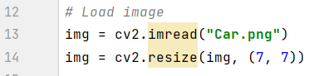
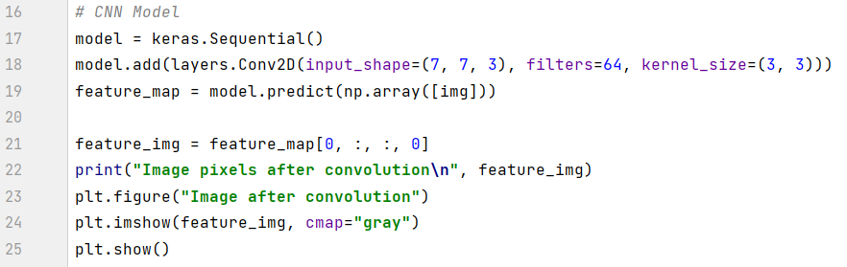
For the convolution layer file:
Firstly, we will load our image and perform the preprocessing step right now:
Secondly, we will build the CNN model including the convolution layer:
We set the image size to (7, 7) only to understand the difference between the two layers output.

Slide 38
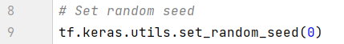
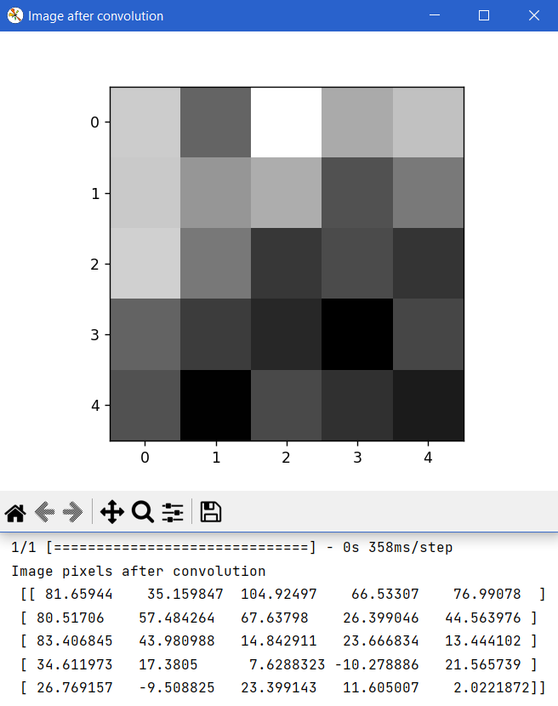
We have to keep the note that Keras generates its weights randomly, so each time we run it, we will get different values for the image list, in this way we can’t compare between the two layers’ output. Thus, we need to fix the weights generated by it and to do this, we set the tensorflow funcion `random.set_seeds()` into 0.
The output of the convolution layer file will be:

Slide 39
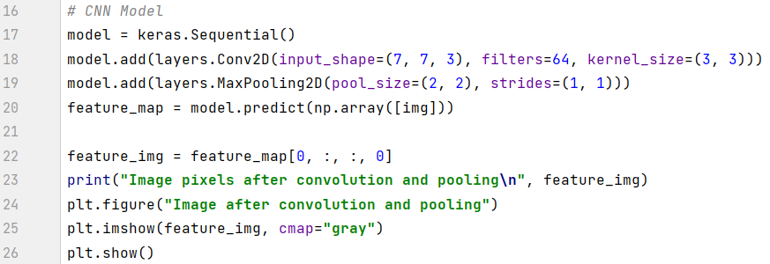
For the convolution + pooling layer file:
After loading the image and setting fixed seeds, we will build the model:

Slide 40
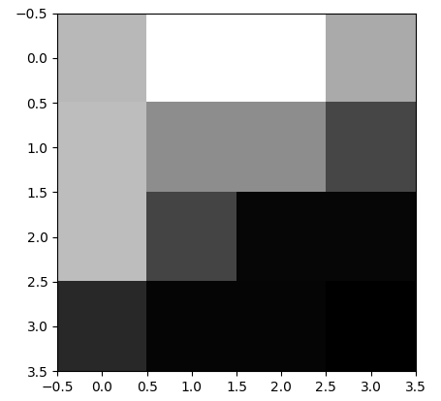
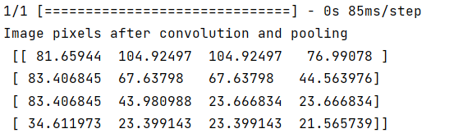
The output of this file will be:
To understand what had happened, we have to understand the parameters of the `MaxPooling2D` function:
pool_size ⇒ It is the subset matrix from the convolution matrix we will apply the max pooling on.
strides ⇒ It is the step that each max pooling will move to the next one.
Max pooling means to find the max pixel value from the subset matrix can create a new pixel with this max value.

Slide 41
`pool_size` parameter further explanation:
If it is set to (2, 2) ⇒ The subset matrix size if (2, 2)
`strides` parameter further explanation:
If it is set to (1, 1) ⇒ Each subset will move by 1 in height and 1 in width to the next subset:
Colored rectangles represents each movement of the pooling.

Slide 42
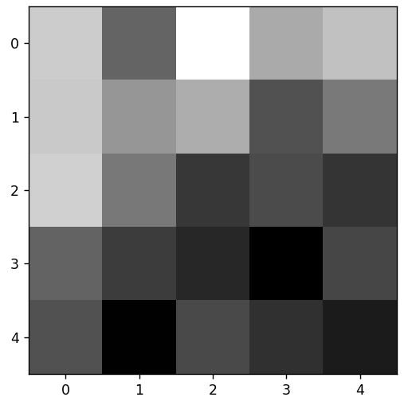
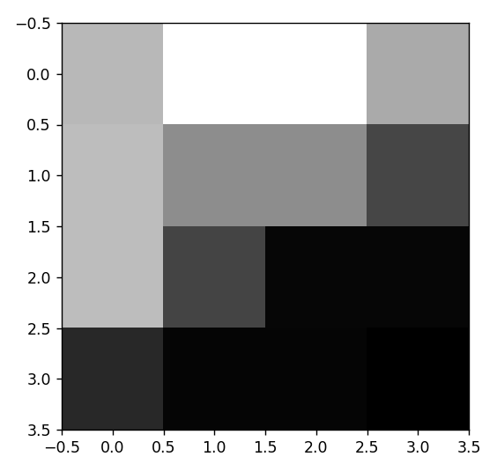
Comparing between the two files’ outputs:
The convolution layer file:
The convolution+pooling layer file:

Slide 43
Max. of the 1st subset matrix = 81.65944
Max. of the 2nd subset matrix = 104,92497
And so on…..
code:
Convolution layer matrix
Convolution + pooling layer matrix code

Slide 44
Content
Libraries installation
Neural network intro.
Image
Neural network structure
Sequential model
Conv2D layer
Feature map
Max Pooling layer
Flatten and Dense layers
Image classification model using VGG16

Slide 45
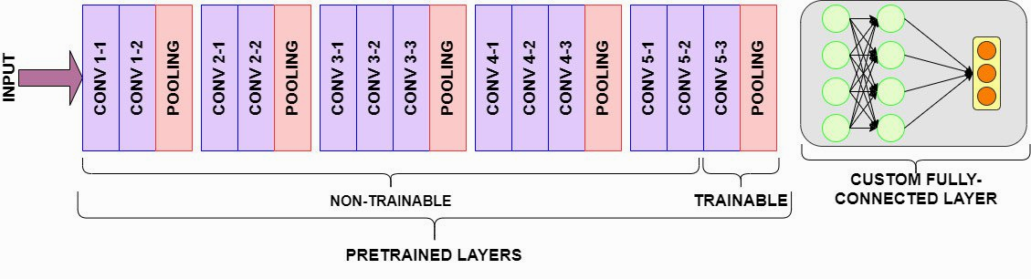
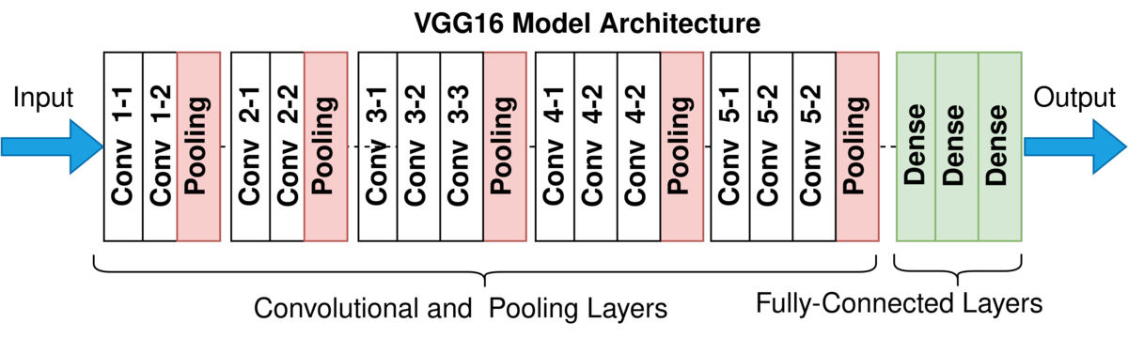
Flatten and Dense layers
Example of a classification neural network architecture (VGG 16 Model):

Slide 46

The Dense layer is a fully connected layer where the final goal is to bring an image of large and multiple values into a small values.
For example, the cat-dog classification problem, we say it is a cat if the output of all the layers is close to 0, and dog if the output of all the layers of neural network is close to 1.
After running our model on our input image, we get a multi-dimensional matrix includes features of the image after processing at layers of neural network, with size of (1, 29, 29, 64)
Now, how can we transform these features/images into just numbers?

Slide 47


This is done through two operations in sequence:
Flatten
Dense
Flatten layer:
Creation:
This layer puts a lot of images together (flattening in English).
The output:
(1, 29*29*64)

Slide 48
Random example for Flatten layer:
If we have such an image of a white vertical line, the img data will be:
data=[0 1 0,
0 1 0,
0 1 0 ]
2. Dense layer:
Creation:
This step is passing the `units` parameter equals to ‘number of neurons’ units, the purpose is to simplifying the information to come with a small numbers.
The shape will be: (1, units number)
After flattening
data=[0 1 0 0 1 0 0 1 0]
Shape = (3, 3)
Shape = (1, 9) ⇒ (1, 3*3)

Slide 49

The output will be:
Here all +53000 features resulted from the convolution and pooling layers will be connected somehow to the units of the dense layer.
This is how the connection is done:
neuron
unit(group of neurons)
Code

Slide 50
Content
Libraries installation
Neural network intro.
Image
Neural network structure
Sequential model
Conv2D layer
Feature map
Max Pooling layer
Flatten and Dense layers
Image classification model using VGG16

Slide 51

Image classification model using VGG 16
VGG 16 model:
A classification model for large-scale image recognition. It achieved 92.7 % accuracy on a dataset with 1000 classes, which means that it could detect 1000 different types of objects on a huge image dataset with +14 million images.
VGG 16 layers:

Slide 52
Model architecture:
Input
images of size 224*224*3
Block #3
Three convolution layers:
Images of size 56*56
256 filters
Activation: relu
One pooling layer:
Images of size 28*28
Block #1
Two convolution layers:
Images of size 224*224
64 filters
Activation: relu
One pooling layer:
Images of 112*112
Block #4
Block #2
Three convolution layers:
Images of size 28*28
512 filters
Activation: relu
One pooling layer:
Images of size 14*14
Two convolution layers:
Images of size 112*112
128 filters
Activation: relu
One pooling layer:
Images of size 56*56

Slide 53
Model architecture:
Block #5
Three convolution layers:
Images of size 14*14
512 filters
Activation: relu
One pooling layer:
Images of size 7*7
Block #6
One flatten layer
Three dense layers:
2 layers of 4096 units and relu activation.
1 layer of 1000 units; for custom models: it is the number of our categories to be classified. VGG16 has been trained on 1000 classes, so the units in its architecture is 1000.

Slide 54


The model takes 224x224x3 images, that how it was developed, so we have to shrink the image to the size suited for the model.
Building the first block:

Slide 55

After running the first two layers, we have to follow the output shape of the features extracted from the convolution layers and make sure they are as the model is setting:
Our output summary:
The model sets the shape must be (224, 224), so why we lose 2 pixels for every convolution layer? The reason is related to the mathematics behind convolution operation.
The solution is to apply the padding.

Slide 56


The output now will be:

Slide 57

Then, we will display the feature map after the first block in this way:
The feature map will be like:

Slide 58


Slide 59
The activation function is by default `activation=”vgg16”`, but the model uses “ReLU”:
For example, we can set it as “ReLU” which is “Rectified Linear Unit activation”.
Some other activation functions give us some result whether it is positive, how positive the number is, and of the result is negative, then how negative the number is.
“relu” ⇒ if that result is positive, it says how much is positive. If it is negative, it just says 0, so it just cut-off the connection with the next neuron.
To set the relu activation:
Then the feature map will be:

Slide 60

The feature map will have many black images, This also takes the concept of cutting off the neuron if the result number is negative.

Slide 61


Building the second block:
The feature map will be:

Slide 62

The model summary:

Slide 63


Building the third block:
The model summary:

Slide 64

The feature map:
So clear that:
The further we go into the network, the features are extracted more in detail.
&& The more we are going depth, the smaller the features are getting the more simpler, but the number of features is increasing.

Slide 65

Building 4th, 5th, and 6th blocks:

Slide 66

The model summary:

Slide 67

How can we understand the output matrix?
We passed 3 units in the last dense layer, so this model will classify between 3 categories, if we passed for example, cat, dog, horse categories in this order, so the order of elements is [cat=0.305629 dog=0.29119745 horse=0.40317357]. The detected animal will have the maximum value. So, for this example, the model classified this animal as horse.
Code

